Slide 1

Image Classification Using CNN (CIFAR-10 Dataset)
( GROUP – 9 )
Presented by: :
SATYAJEET SAHU
ANIRBAN DUTTA
SATYAM DIBYAJYOTI NAYAK

Slide 2
Content:
CIFAR-10: 60,000 images (32×32 px) across 10 classes (e.g., cat, dog, car, plane).
CNNs: Deep learning models ideal for image pattern recognition.
Project Focus: Load data, build CNN, train, evaluate, and predict.
Goal: Classify images accurately using a custom CNN in TensorFlow/Keras.
Data Preparation: Load and normalize CIFAR-10 images
Model Design: Build a CNN using TensorFlow & Keras
Training & Evaluation: Train the model and check accuracy
Result Analysis: Visualize performance and predictions

Slide 3
Environment Setup :
Platform :
Jupyter Notebook with GPUs: T4, V100, A100
Libraries :
TensorFlow
Numpy
Matplotlib

Slide 4
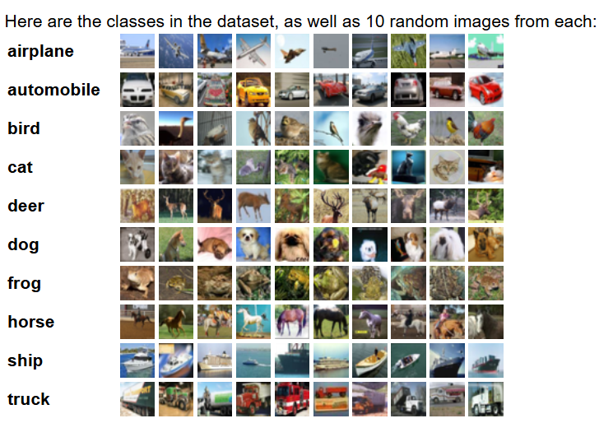
#0
#1
#2
#3
#4
#5
#6
#7
#8
#9

Slide 5
Data Preprocessing & Visualization
Normalization
(images / 255)
Visualization
Plot sample images with labels

Slide 6
Code Architecture
tensorflow / keras: Core deep learning libraries used to build and train the CNN model.
numpy: Used for numerical operations and array handling.
matplotlib.pyplot: For visualizing images from the dataset.
cifar10.load_data(): Loads the CIFAR-10 dataset, splitting it into training and testing sets.
x_train, y_train / x_test, y_test: Variables that hold training and testing data and their corresponding labels.
x_train.shape / x_test.shape: Used to check the dimensions of the data.
plt.imshow(): Displays image data visually.
x_train / 255.0, x_test / 255.0: Normalizes pixel values to the [0, 1] range for better model performance.
Sequential(): Initializes a linear stack of layers for the CNN model.
Conv2D(filters, kernel_size, activation): Adds a 2D convolutional layer that extracts features from input images.
MaxPooling2D(pool_size): Reduces the spatial dimensions of the feature maps.

Slide 7
Flatten(): Converts the 2D feature maps into a 1D vector for input into dense layers.
Dense(units, activation): Fully connected layer that performs classification based on extracted features.
model.compile(): Configures the model with optimizer, loss function, and evaluation metric.
optimizer='adam': Optimizer that adjusts learning rate adaptively during training.
loss='sparse_categorical_crossentropy': Suitable loss function for multi-class classification with integer labels.
metrics=['accuracy']: Tracks the accuracy of the model during training and evaluation.
model.fit(x_train, y_train, epochs, validation_data): Trains the model using training data over multiple iterations (epochs).
model.evaluate(x_test, y_test): Evaluates model performance on unseen test data.
model.predict(x_test): Predicts class probabilities for the test images.
np.argmax(): Converts prediction probabilities into final class labels.

Slide 8

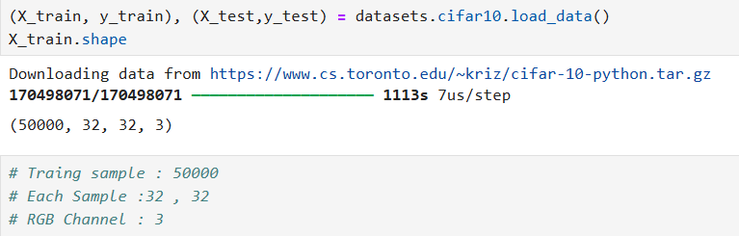
1
Importing Necessary Libraries
2
Loading the Dataset

Slide 9
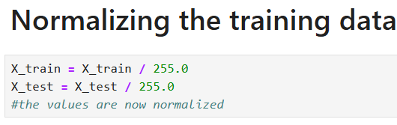
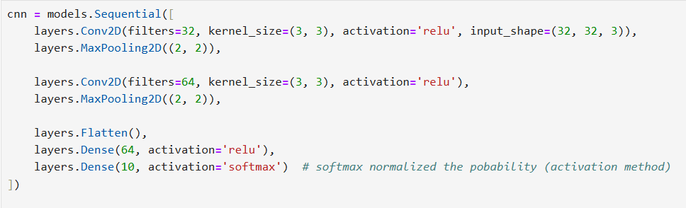
3
Normalization of dataset
4
Defining the CNN Architecture

Slide 10

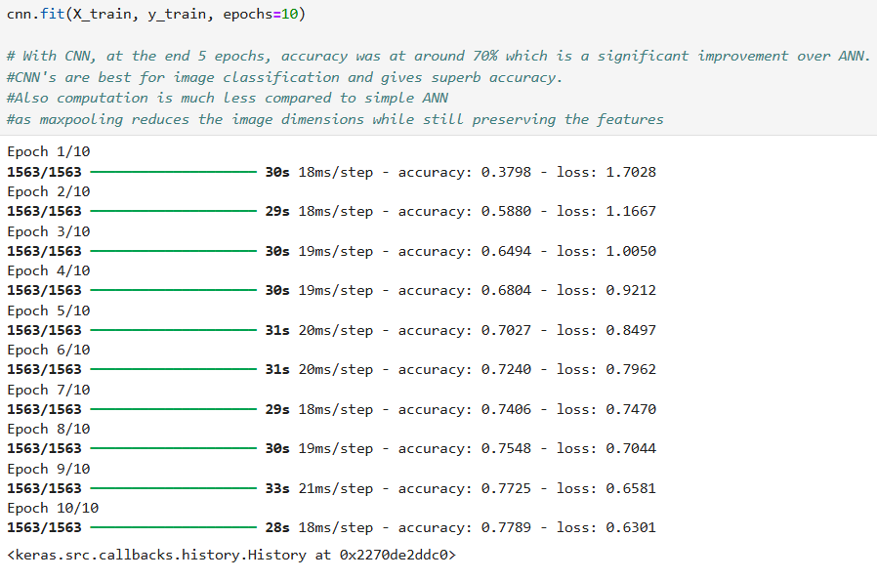
5
Compiling and Training the Model

Slide 11
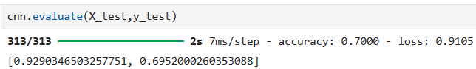
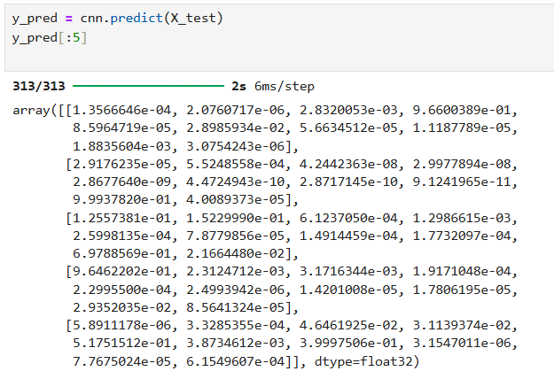
6
Evaluating Model Performance
7
Model Predictions

Slide 12
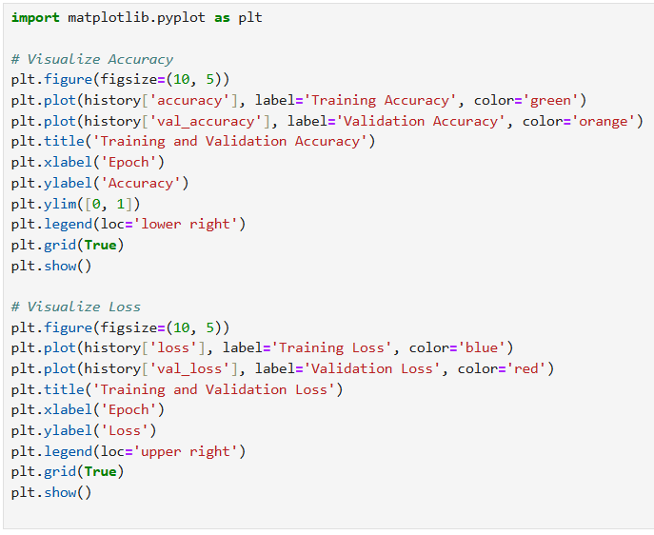
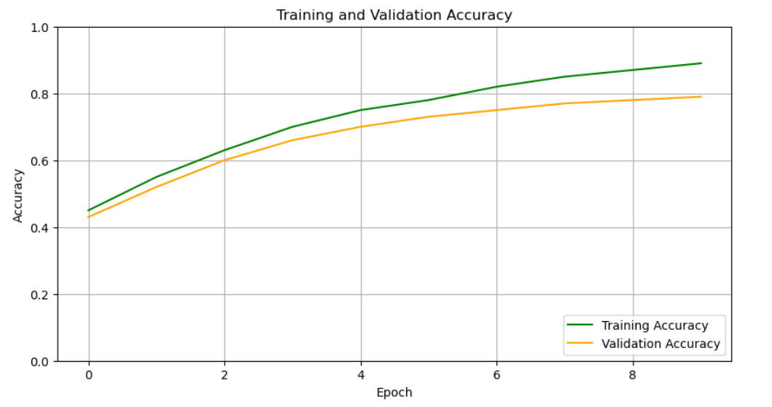
9
Visualizing Training History (GRAPH)

Slide 13
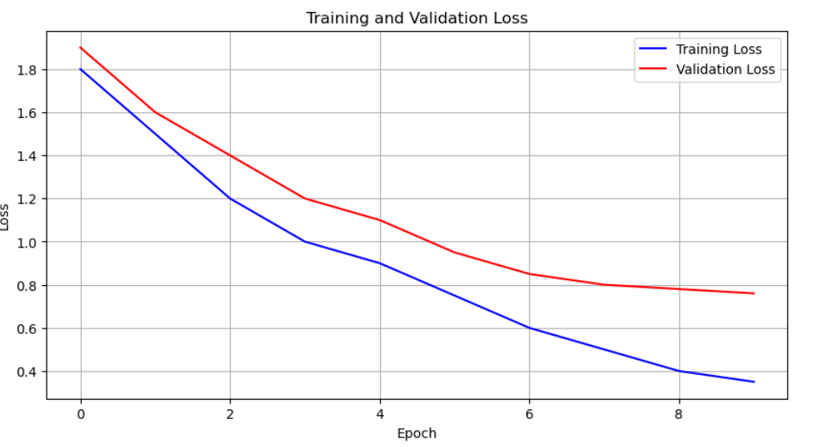

Slide 14
Summary :
The model achieved a test accuracy of ~70%, indicating it correctly classified over 70% of unseen images.
Final test loss was 0.9105, which suggests room for further optimization.
Future improvements could include:
Using data augmentation to improve generalization
Adding dropout layers or batch normalization
Experimenting with more complex architectures like ResNet or VGG
Thanks for taking the time to view this project on image classification using CNNs.
Feel free to reach out with any questions or suggestions!
Happy Learning!

